Slide 1

NBA Team Win Rate Predictor
Jiaheng Wang

Slide 2
Model
Source: Using nba_api to collect 2014-15 ~ 2023-24 regular season NBA team stats.
Variables(13 team-level features per season):
Shooting & scoring: FG_PCT, FTM, TOP3_PTS
Ball movement & defense: AST, STL, BLK, DEF_RATING
Pace & style: PACE, OFF_RATING, TOV, etc.
Model: W_PCT=β0​+β1​⋅FG_PCT+β2​⋅FTM+β3⋅REB+...
to determine the feature contribution leading to the game winning/ higher win rate

Slide 3
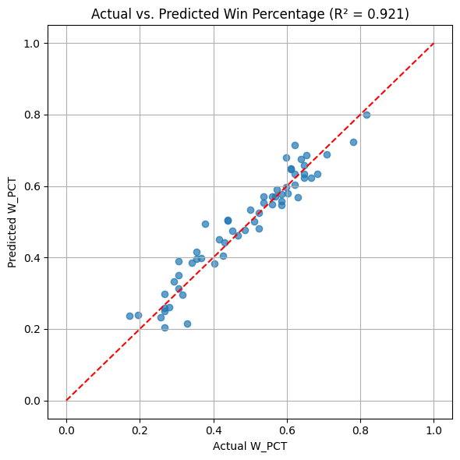
Performance
R² Train | 0.9325
R² Test | 0.9208
MAE | 0.0345
MSE | 0.0019

Slide 4
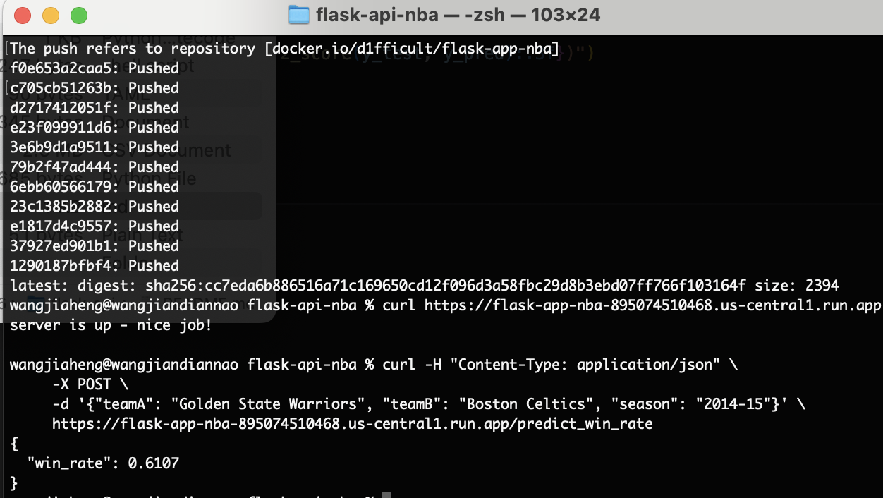
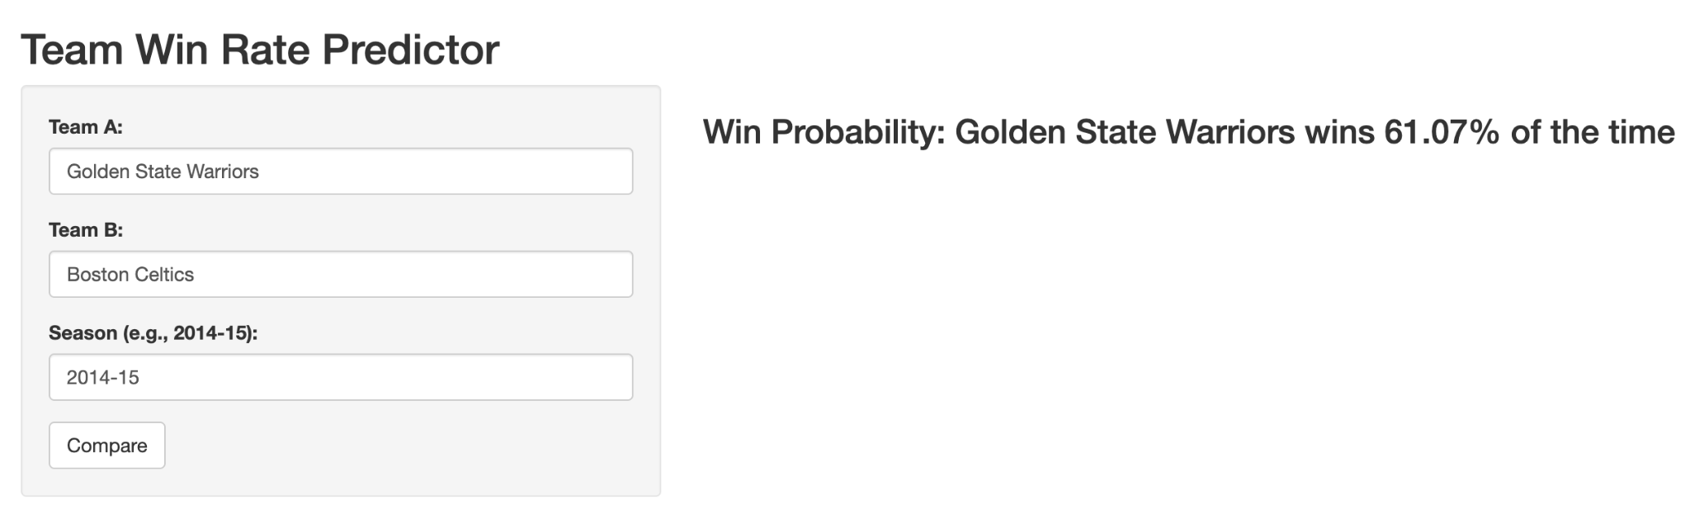
Deploy
Google Cloud Run
Endpoint: https://flask-app-nba-895074510468.us-central1.run.app
Provide teamA, teamB and season, the expected win rate of team A against team B will be provided.
Shinyapps:
Deployed to https://d1fficult.shinyapps.io/shinyapp/

Slide 5
Conclusion&Future Work
Trained a linear regression model to estimate team win percentage with high accuracy (R² ≈ 0.92).
Used model predictions to compute head-to-head win probabilities between any two teams in a selected season.
Deployed using Google Cloud Run and shinyapps.io
Future work: integrate game-level data, test more complex models (e.g., XGBoost, logistic regression), and expand to playoff predictions

